Slide 1

Chapter 01
Introduction
CONCEPTS OF ECONOMICS

Slide 2

Concepts of Economics
Basic Questions??
Why some nations are rich?
Nations can print money but still some countries are poor.

Slide 3
Economic Prosperity
Concepts of Economics
Natural Resources
Human Capital
Political Stability
Infrastructure
Economic Policies
International Trade
Financial System
Rule of Law
Innovation and Technology
Historical and Cultural Factors
Introduction

Slide 4
Concepts of Economics
Misconceptions
It is dry and academic, due to its reliance on statistics, graphs, and formula
It is all about money
So, What is economics
Introduction

Slide 5
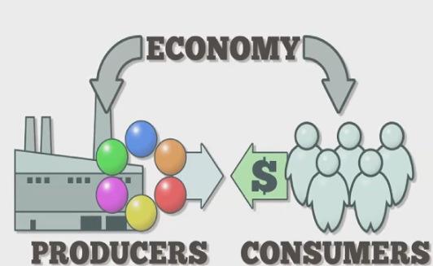
ECONOMY
Concepts of Economics
The system by which goods and services are produced, sold, and bought in a country/region.
Introduction

Slide 6
TYPES OF ECONOMIES
Concepts of Economics
Market Economy
Driven by supply and demand with minimal government intervention.
2. Command Economy
Centrally planned, where the government controls production and distribution.
3. Mixed Economy
Combines elements of both market and command economies, common in most countries.
Introduction

Slide 7
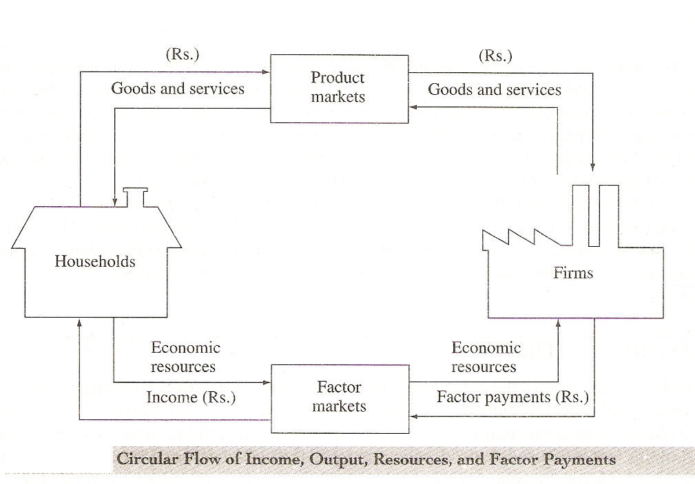
Circular Nature of Economy
Concepts of Economics
Introduction

Slide 8
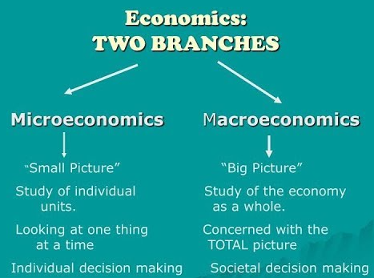
Concepts of Economics
Economics
Is the social science that studies the behavior of individuals, businesses, and societies concerning the production, distribution, and consumption of goods and services.
Introduction

Slide 9
Concepts of Economics
Economics
Key Concepts in microeconomics
Supply and Demand
Consumer Behaviour
Producer Behaviour
Market Structure
Elasticity
Key Concepts in macroeconomics
GDP
Inflation
Unemployment
Fiscal Policy
Monetary Policy
Introduction

Slide 10
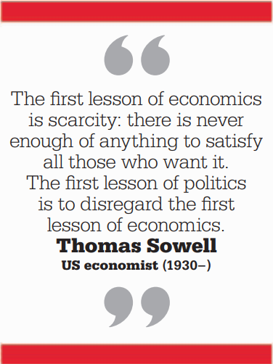
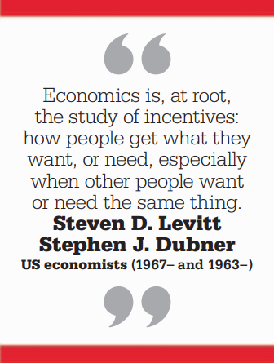
Concepts of Economics
Economics
The word is derived from the Greek word Oikonomia, meaning
“household management”
Introduction

Slide 11
Concepts of Economics
Economics: The Study of Scarcity and Choice
Economics is a social science that examines how individuals, businesses, and societies allocate scarce resources to satisfy unlimited wants and needs.
Why Economics Matters
Economics helps us understand how markets function, how policies impact the economy, and how societies can improve their living standards.
Introduction

Slide 12




Concepts of Economics
Central Problem of an Economy
Ideology
Introduction

Slide 13
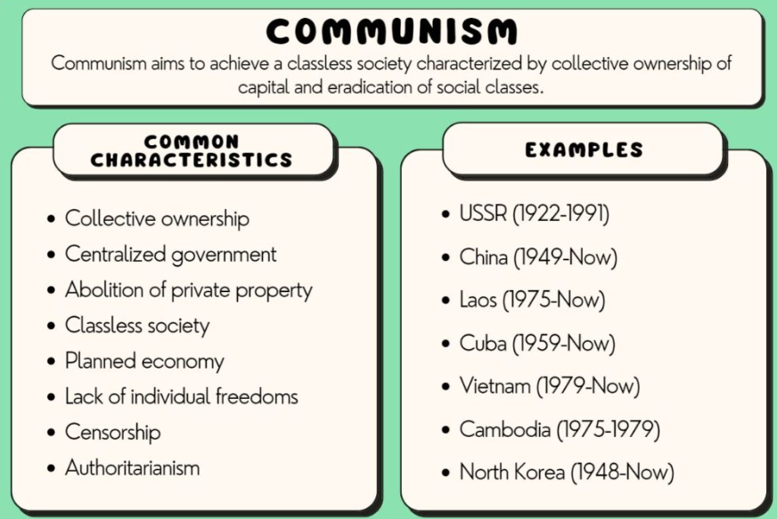
Communism
Concepts of Economics
Advantages:
Elimination of Class Struggles
Central Planning
Social Equality
Disadvantages
Lack of Incentive
Centralization of Power
Limited Individual Freedom
Introduction

Slide 14
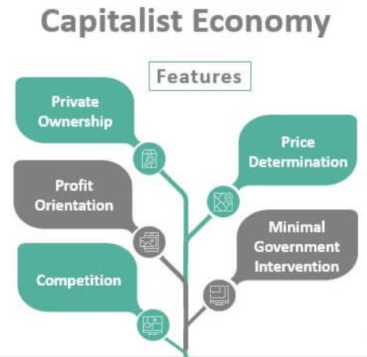
Capitalism
Concepts of Economics
Advantages:
Economic Efficiency
Individual Freedom
Consumer Choice
Disadvantages
Income Inequality
Lack of Social Safety Nets
Environmental Concerns
Introduction

Slide 15
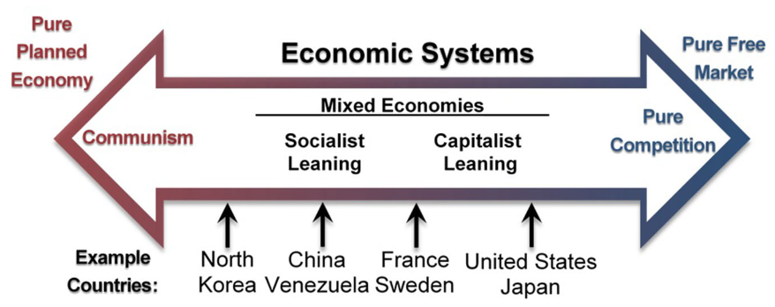
Mixed Economy
Concepts of Economics
Introduction

Slide 16
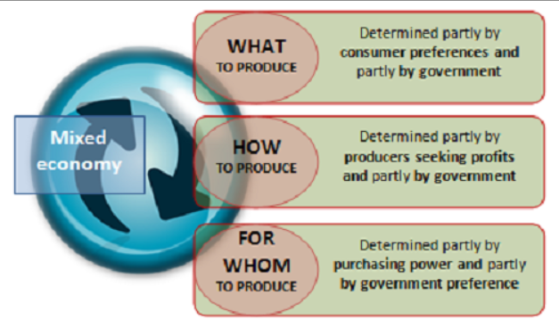
Mixed Economy
Concepts of Economics
Advantages:
Balancing Efficiency and Equality
Government Intervention
Diversity of Economic Activities
Disadvantages
Inefficiency
Political Debate
Introduction

